Slide 1

COVID-19 & Cyber Attacks
Jarratt Davis, Kevin Luse, Justin Prosser John Williams

Slide 2

Concept of Application

Slide 3
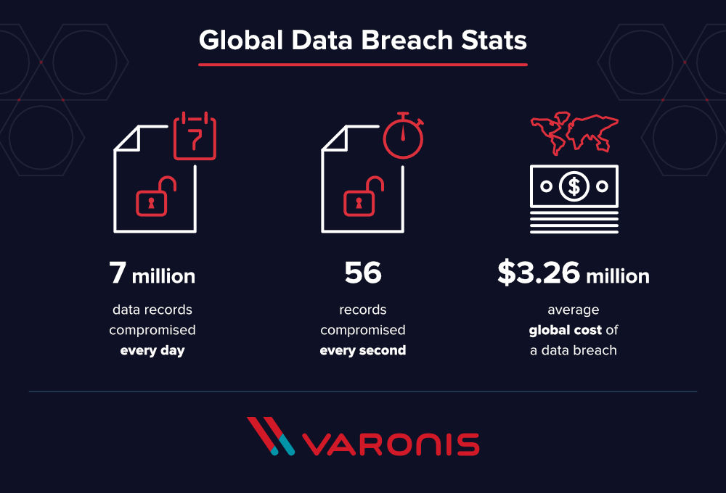
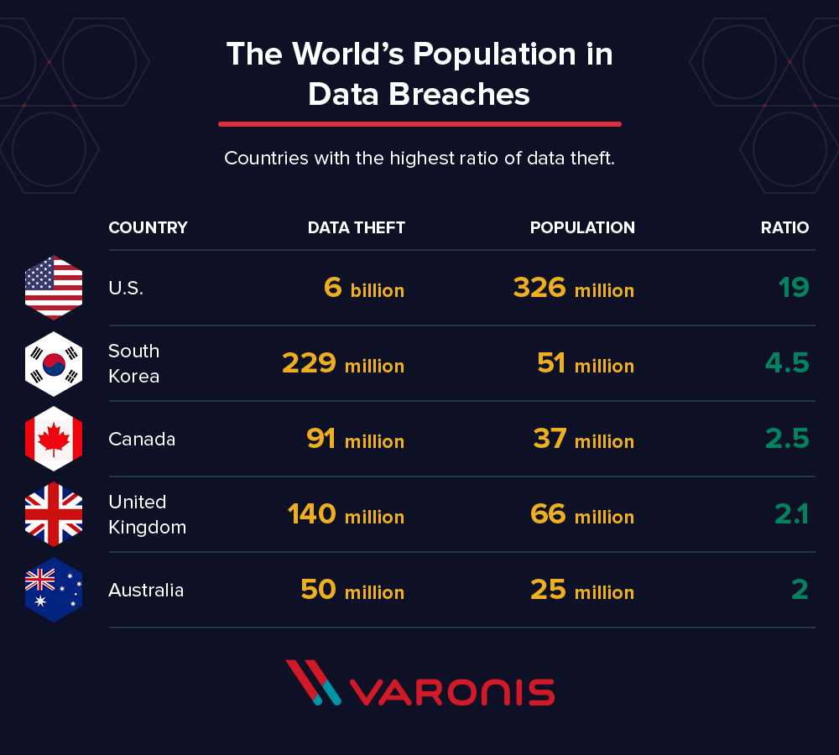
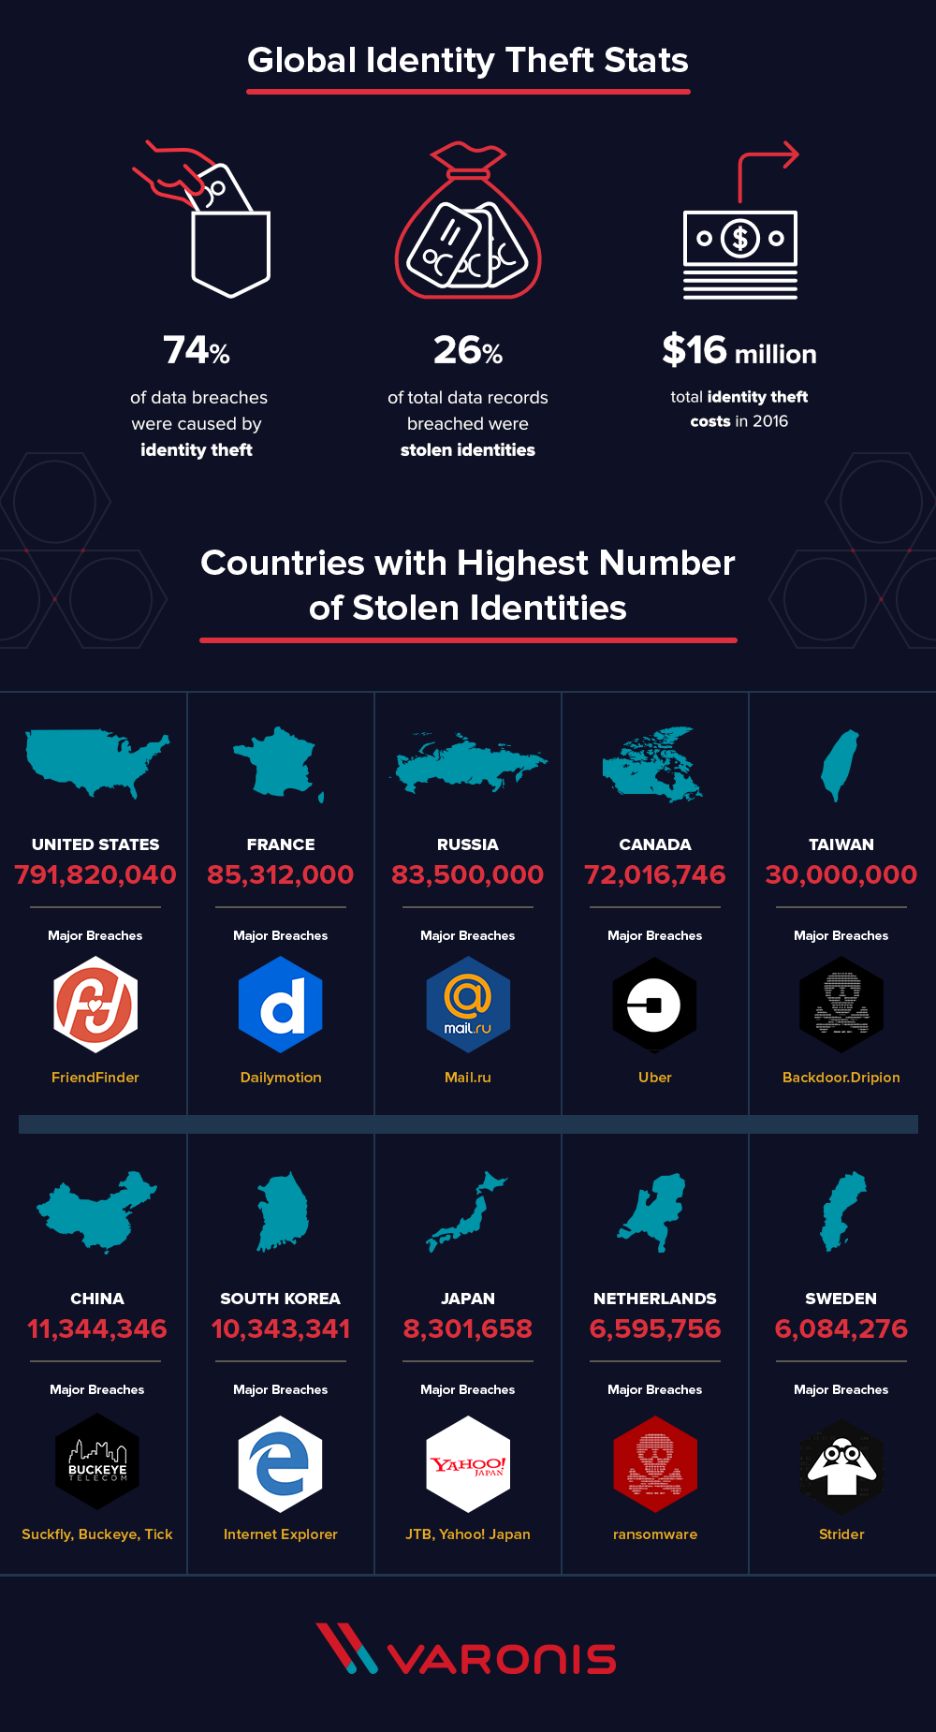
Quick Figures
(https://www.varonis.com/blog/the-world-in-data-breaches/)
Notes:
https://www.varonis.com/blog/the-world-in-data-breaches/

Slide 4
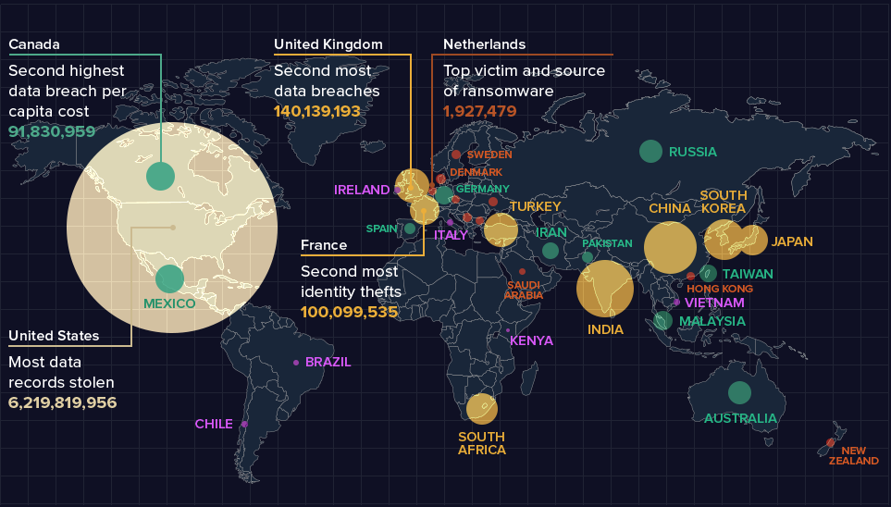
https://www.varonis.com/blog/the-world-in-data-breaches/
Notes:
https://www.varonis.com/blog/the-world-in-data-breaches/

Slide 5
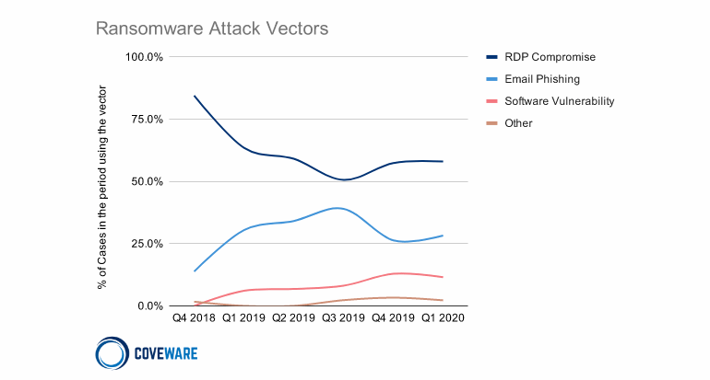
Ransomware Attack Vectors
https://www.zdnet.com/article/kaspersky-rdp-brute-force-attacks-have-gone-up-since-start-of-covid-19/
Notes:
https://www.zdnet.com/article/kaspersky-rdp-brute-force-attacks-have-gone-up-since-start-of-covid-19/

Slide 6
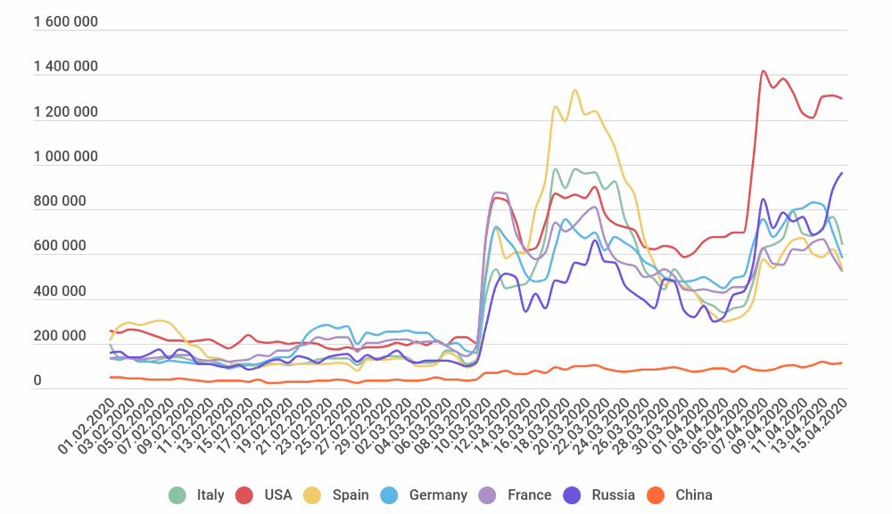
Brute force attempts during COVID-19
https://www.zdnet.com/article/kaspersky-rdp-brute-force-attacks-have-gone-up-since-start-of-covid-19/
Notes:
https://www.zdnet.com/article/kaspersky-rdp-brute-force-attacks-have-gone-up-since-start-of-covid-19/

Slide 7

Topics of Concern in 2020
Things the attacker might be trying to do:
Target Infrastructure: 4% (could they attack another business further down the road)
Internal vs. External detection:
Are companies able to detect if they have been breached?
If they are using a third party client to do the monitoring then they will be within the median for average dwell time
Internal detection means that they would be ahead of the curve because they would be well below the average dwell time (anywhere between 30-40 days)
Notes:
If using a third-party contractor
Re-attack rate: 31%

Slide 8
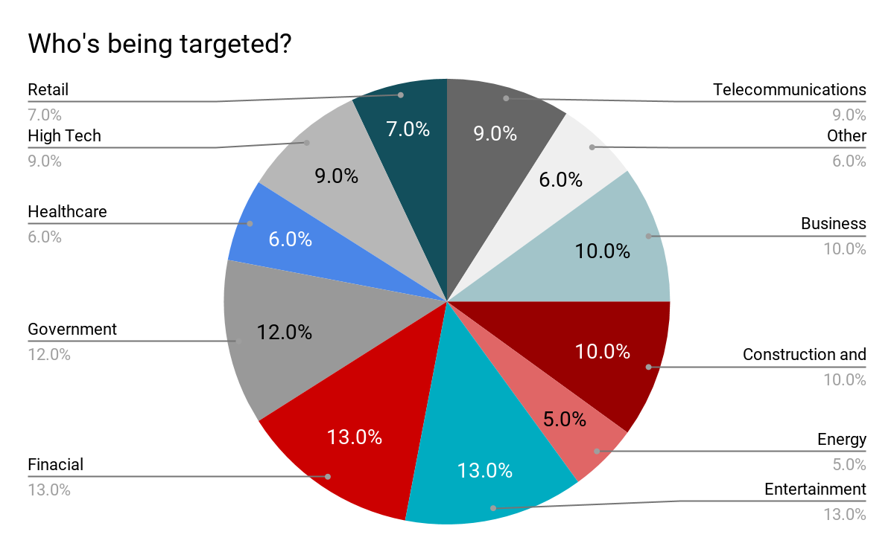
https://www.fireeye.com/current-threats/annual-threat-report/mtrends.html
Notes:
Interesting to note that Entertainment is one of the top attack vectors
https://www.fireeye.com/current-threats/annual-threat-report/mtrends.html

Slide 9
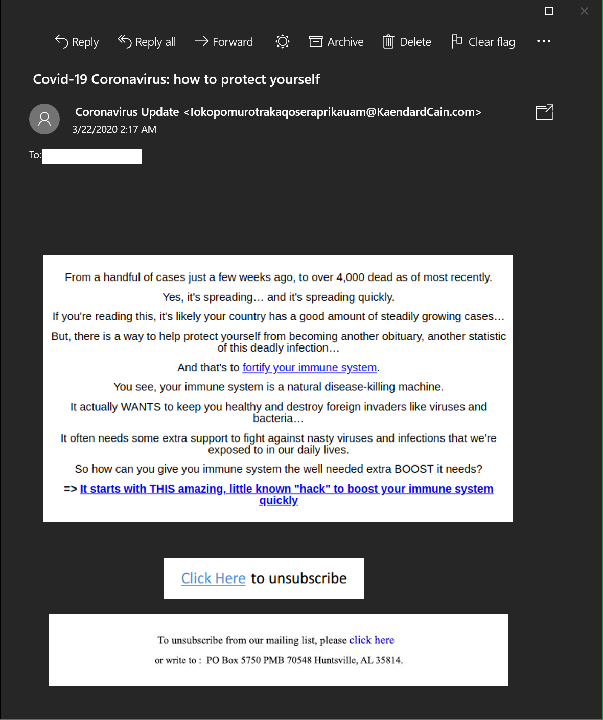
Are cyber attacks slowing during COVID-19?
Some attack vectors have seen an increase:
Ransomware
Phishing attacks
New Vulnerabilities
Home networks
Healthcare
Equipment and Supplies
Finance
Stimulus/Payroll Protection Program
Notes:
Healthcare related phishing attacks are increasing
Call back to demo running back in the background

Slide 10

What should you do?
Accept that a breach is inevitable:
Educate yourself and the people around you
Have a backup
Monitor your system
External (third-party)
Internal (in-house)
Train your filter
Notes:
User education is a fantastic way to eliminate most clicked links however the more protection offered the less likely links are going to be clicked

Slide 11
Check in on our attack!

Slide 12
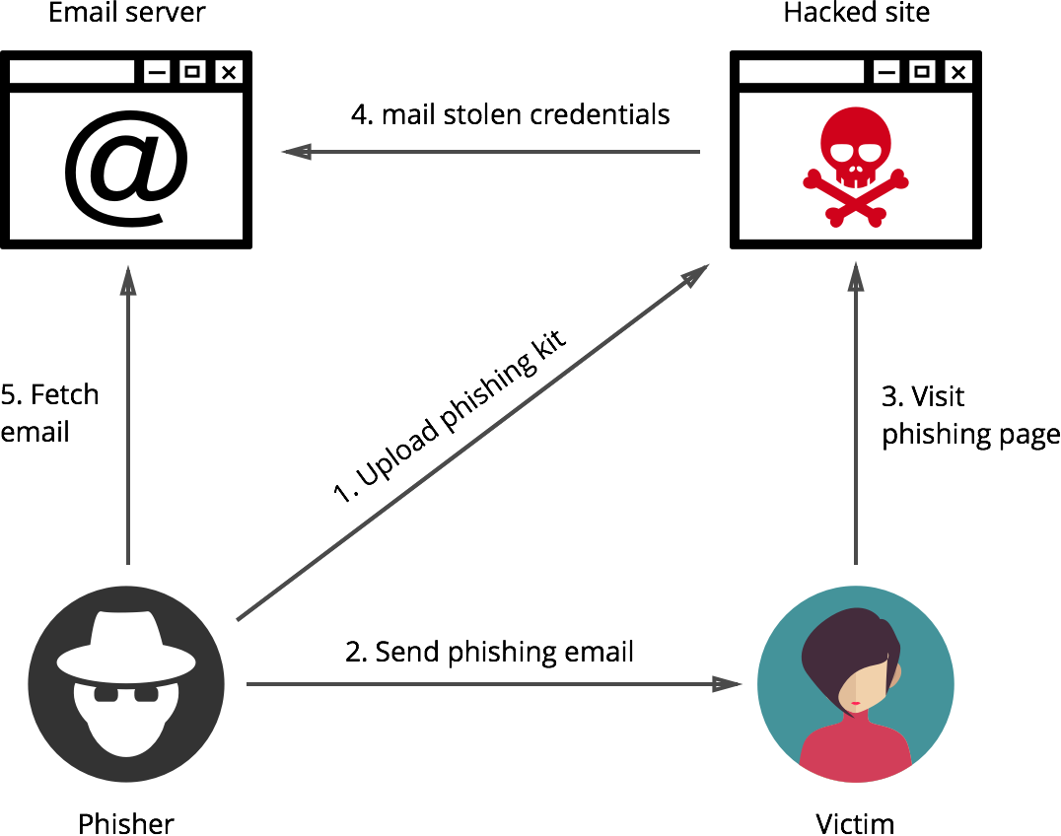
How does it work?
Email server
Bad site/ Email
4. Mail stolen credentials
5. Fetch email
3. Redirected link/page
1. Upload phishing kit
2. Send phishing email
Attacker
Victim
Flow chart by Elie Bursztein

Slide 13
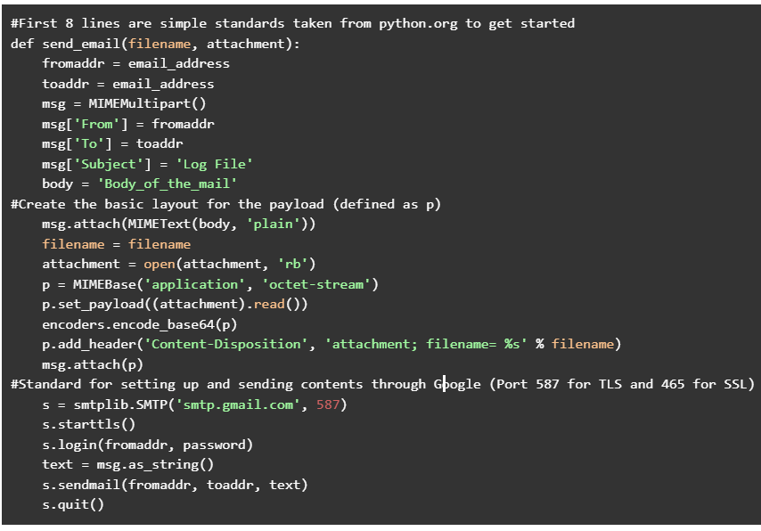
The Code

Slide 14
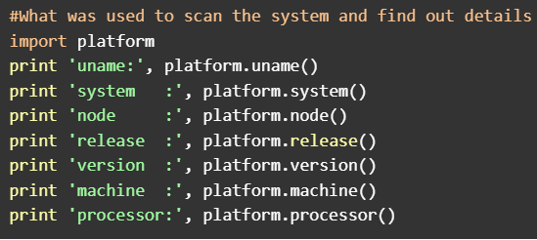

Slide 15
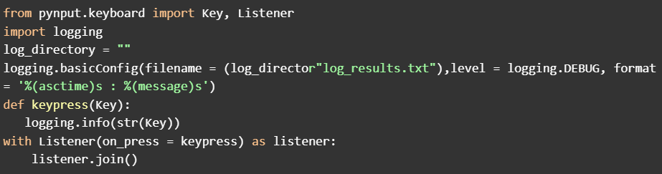

Slide 16
Mitigation Techniques
Common Mitigation Techniques (email):
Change passwords (use complex characters and numbers)
Enable Two-factor authentication
Reach out to any business that may use the breached information
Transition to a new email address.
Filtering (internal/ external)
Common Mitigation Techniques (Keyloggers)
Keep system up to date
Anti-malware/ Anti-virus
Key encryption
Use on-screen keyboard
Check your task manager for unknown programs running.
Some keyloggers like to disguise themselves as legitimate programs
Notes:
User education is a fantastic way to eliminate most clicked links however the more protection offered the less likely links are going to be clicked
Keyloggers are not easy to fix so constant monitoring helps mitigate the chances of one running, If you are unsure of what a running program is, google it!

Slide 17
Table of contents
https://www.ftc.gov/system/files/attachments/coronavirus-covid-19-consumer-complaint-data/covid-19-daily-public-complaints.pdf
https://www.varonis.com/blog/the-world-in-data-breaches/
https://www.zdnet.com/article/kaspersky-rdp-brute-force-attacks-have-gone-up-since-start-of-covid-19/
https://securityboulevard.com/2019/12/how-to-mitigate-phishing-threats-inyour-organization/
https://www.fireeye.com/current-threats/annual-threat-report/mtrends.html
https://www.pcworld.com/article/3072435/5-ways-to-stop-spam-from-invading-your-email.html
https://enterprise.comodo.com/how-to-prevent-keylogging.php
Useful tools/ links
https://haveibeenpwned.com/
https://gizmodo.com/how-to-make-sure-important-emails-stay-out-of-your-spam-1832989347
https://safety.google/securitytips-covid19/
https://www.justice.gov/coronavirus
https://securityboulevard.com/2019/12/how-to-mitigate-phishing-threats-inyour-organization/
https://www.eff.org/deeplinks/2020/03/phishing-time-covid-19-how-recognize-malicious-coronavirus-phishing-scams
https://us.norton.com/internetsecurity-online-scams-coronavirus-phishing-scams.html
https://www.expertinsights.com/insights/top-11-email-security-gateways/
https://www.g2.com/categories/secure-email-gateway
https://en.wikipedia.org/wiki/Anti-spam_techniques
https://www.privateinternetaccess.com/blog/how-to-protect-against-keyloggers/

Slide 18
The End
Any questions?

Slide 19
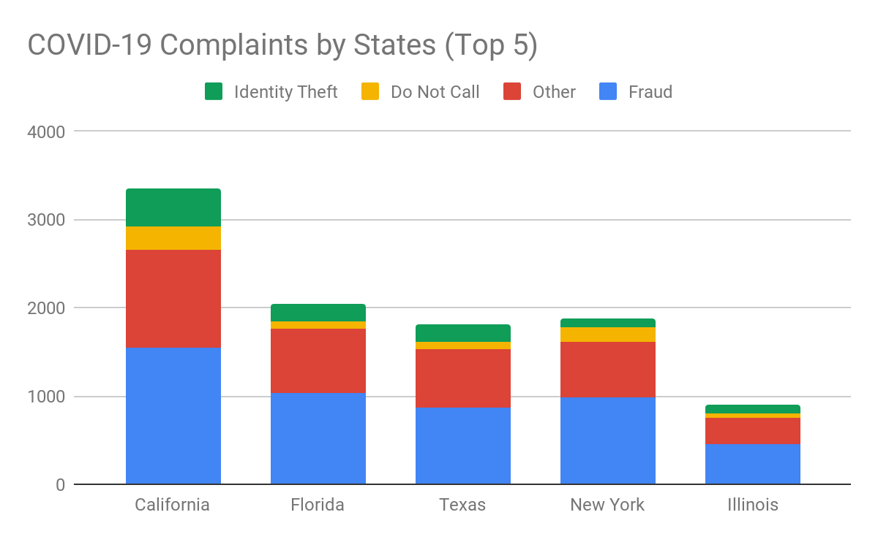

Slide 20
What's old is new again - What have we learned?
Malware:
Old and new families being developed
59% of known malwares are being used again
Known attacks being used:
Compromised credentials
Privilege escalation
Valid access
Dwell time down:
416 days: 2011
56 days: 2019
Groups:
APT-41 (China)
Old and new groups
Diverse goals
Notes:
Dropper and Backdoor

